Slide 1
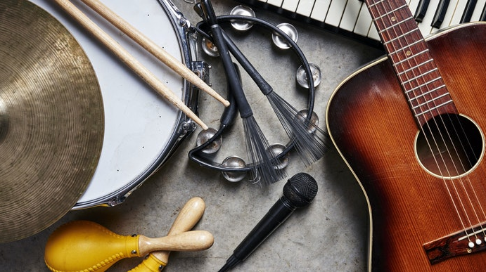
Music SQA Study Skills
National 5, Higher and Advanced Higher

Slide 2

How is the course broken up?
The Performance element of the course is worth 60% of your overall mark.
Understanding Music (Listening) element of the course is worth 40% of your overall mark.

Slide 3
National 5 Performance Requirements
You have the option of performing on either:
  Two instruments or one instrument and voice
  One instrument or voice
If you have chosen to be assessed on one instrument or voice, you will need to perform more pieces on your selected instrument (or voice).
Your programme must be a minimum of 6 minutes, and a maximum of 6 minutes 30 seconds.

Slide 4
Higher Performance Requirements
You have the option of performing on either:
  Two instruments or one instrument and voice
  One instrument or voice
If you have chosen to be assessed on one instrument or voice, you will need to perform more pieces on your selected instrument (or voice).
Your programme must be a minimum of 10 minutes, and a maximum of 11 minutes.

Slide 5
Advanced Higher Performance Requirements
You have the option of performing on either:
  Two instruments or one instrument and voice
  One instrument or voice
If you have chosen to be assessed on one instrument or voice, you will need to perform more pieces on your selected instrument (or voice).
Your programme must be a minimum of 15 minutes, and a maximum of 17 minutes.

Slide 6
How can I study for Performance?
You should practice for a minimum of 20 minutes per day.
There are many different practising techniques that you can use, such as:
  Identify bars or phrases that you find difficult and focus on those for the session.
  Practice under tempo – practice the bar at a slower pace, then gradually speed it up until you can play it at full tempo.
  Don’t always start from the beginning – try practising the middle or final section.

Slide 7
How can I study for Performance?
  Record yourself and listen back – this will highlight any areas in which you need to focus.
  If appropriate, practice with your backing track.
  Build your stamina
    Play pieces from beginning to end.
    Try playing your entire programme.
Remember, you should practice for a minimum of 20 minutes a day.

Slide 8
Hints and Tips for Performance
Your performance will be assessed against the following criteria:
  Melodic accuracy/intonation
  Rhythmic accuracy
  Tempo and flow
  Mood and character
  Tone
  Dynamics

Slide 9
How can I study for Listening?
You should regularly revise listening concepts at home.
Make sure to look over your concept dictionaries and booklets (available both digitally on Teams and the handouts you received in class).
Go to Ataea and My Music Online for concept definitions.
You can also access quizzes on My Music Online, which can be a very useful tool when learning how to identify concepts from audio excerpts.

Slide 10

Links for Revision Materials
Check out these links for Music listening concepts.
My Music Online
  https://mymusiconline.co.uk/
Ataea
  https://ataea.co.uk/index.php/Welcome

