Slide 1
Design and Technology Department
SQA Study Skills 20-21

Slide 2
Study Skills
How to prepare for studying It is essential that you take time to prepare and organise yourself before you study for all of your SQA exams.
General preparation:
Leave enough time to revise – do not cram revision in the night before an exam
Keep your class notes and jotters neat and organised throughout the academic year
Find a quiet place to study and organise your materials
Put your mobile phone off and in another room
Eat ‘brain food’ before you begin studying
Set goals and take regular breaks to retain your attention and focus (study a little and often) Why not try out the Pomodoro technique: https://www.youtube.com/watch?v=1l4w7uHdNaQ

Slide 3
Study Skills
How to prepare for studying Revision Timetable It is important to manage your time. Create a revision timetable and allocate time to each of your subjects. Remember to leave time for breaks and revision should be done in short chunks of time. See example:
School Day
Design & Man.
School Day
PE
Gymnastics
School Day
English
School Day
Maths
Football
Biology Supported study
School Day
Design & Man.
PE
English
Family Sunday lunch
Maths
Biology

Slide 4
Study Skills
Weekly Revision Timetable

Slide 5
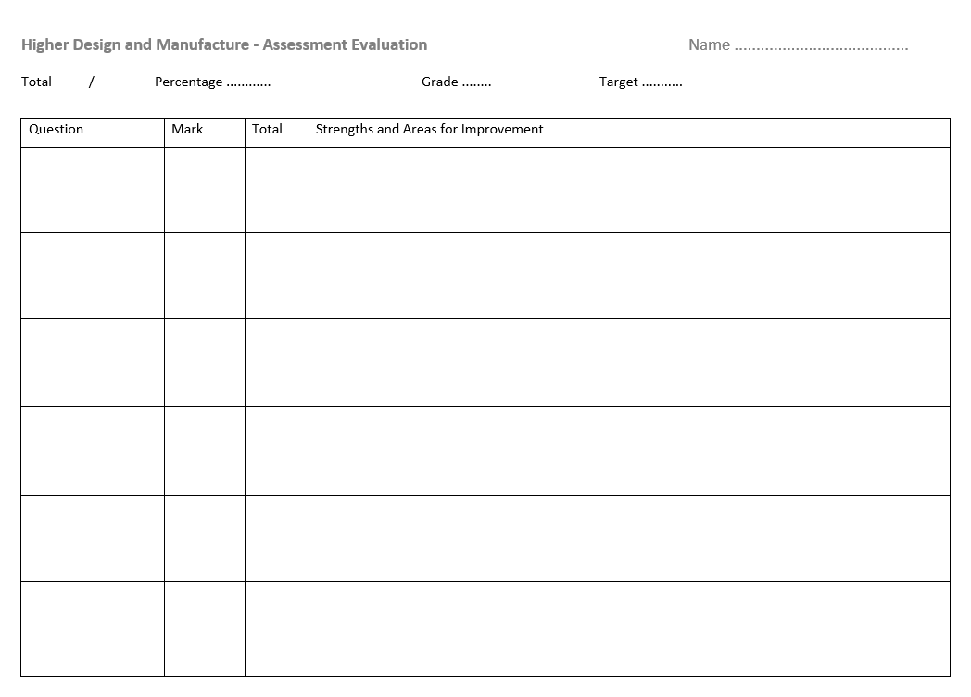
Study Skills
How to prepare for studying What to Study?
Break studying down into each unit of work. Use the course specification on OneNote as a revision checklist. See link below: Course Checklist (Web view)
Now time to reflect. For each unit of work, highlight your strengths and areas for improvement – this information could come from end of unit tests, test evaluation forms, feedback of coursework and homework. Highlight strengths in green on the revision checklist. These areas should be re-capped. Highlight in amber or red areas you found more challenging. More in-depth revision can be done for these areas.
Gymnastics

Slide 6
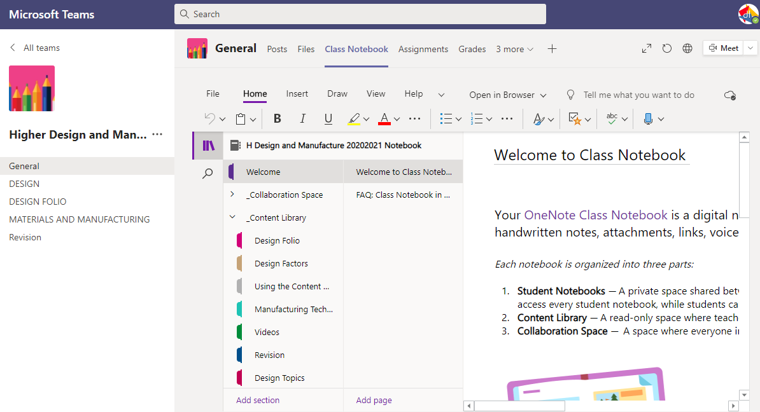
Study Skills
Resources Class Notes
Course notes provided throughout the year by your teacher can be used to help you revise each unit of work covered in class.
Microsoft Teams and OneNote Accessing Microsoft Teams via Glow will enable you to gain access to digital copes of class notes and PowerPoint presentations OneNote which is accessed via Teams contains a variety of your course notes, revision materials and class work.
Gymnastics

Slide 7
Higher Graphic Communication
SQA Study Skills 2020-21

Slide 8
HIGHER GRAPHIC COMMUNICATION
Study Skills
What do you need to know to pass exams in Graphic Communication?
Many pupils may skip quickly through a pages like these.
After all, we all know how to revise or do we really? Think about this;
“ IF YOU ALWAYS DO WHAT YOU ALWAYS DO, YOU WILL ALWAYS GET WHAT YOU HAVE ALWAYS GOT.”
Are you happy with your grades or do you want to do better? If you get full marks in your assessments, then that’s great… change nothing!
This information is just to help you get that little bit better than you already are. There are two main parts to the advice: The first part highlights obvious things which are also very important. The second part makes suggestions about revision that you might not have thought about, but which WILL help you.

Slide 9
Higher Graphic Communication
Study Skills
Part 1 Start revising in good time! Don’t leave it until the last minute – this will make you panic. Make a revision timetable that sets out work time AND relaxation time. Sleep and eat! Obvious really, and very helpful. Avoid stressful things too – even games that wind you up. You need to be fit, awake and focused! Know where it takes place and what to expect! Make sure you know exactly WHEN and WHERE your exams are. Make sure you know what to expect in the exam. How is the paper structured? How much time is there for each question? What types of question are involved? Which topics seem to come up time and time again? Which topics are your strongest and which are your weakest? Learn by doing! There is no substitute for past papers and practice papers – they are essential! Tackling a collection of exam papers and answers is exactly the right thing to be doing, as your exams approach. |  | Part 2 People learn in different ways. Some like low light, some bright. Some like early mornings, some like evening/ night. Some prefer warm, some prefer cold. However, everyone uses their BRAIN, and the brain works when it is active. Passive learning ie. sitting gazing at notes, is the most INEFFICIENT way to learn anything. On the following pages you will find tips and ideas for making your revision more effective and maybe even more enjoyable. What follows gets your brain active, and active learning works. Remember there are numerous ways to do this…you just need to find a method that works for you!

Slide 10
Higher Graphic Communication
Study Skills
Activity 1 – Stop & Review Step 1 When you have done no more than 5 minutes of revision reading STOP! Step 2 Write a heading in your own words which sums up the topic you have been revising. Step 3 Write a summary of what you have revised in no more than two sentences. Don’t fool yourself by saying, ‘I know it, but I cannot put it into words’. That just means you don’t know it well enough. If you cannot write your summary, revise that section again, knowing that you must write a summary at the end of it. Many of you will have notebooks full of blue/black ink writing. The pages will not be especially attractive or memorable so try to liven them up a bit with colour as you are reviewing and rewriting. This is a great memory aid, and memory is the most important thing. |  | Write what you know from memory on a blank sheet: A plain sheet of paper is a very under-rated study tool! Put your books away, then scribble down everything you can remember about a topic. After you’ve squeezed out as much as you can from memory, you can go back and add in any missing details in a different coloured pens. Next time you revise this topic, aim to have fewer missing details – until you have none, come the week before the exam! Below, are some links that you can ‘Click on’ that may help you to train your brain, but YouTube has many more!
Highlighting Information Properly
Train your brain to remember.
Colour Coding and how to do it.

Slide 11
Higher Graphic Communication
Study Skills – Activities
Activity 2 – Use Technology Not everything needs to be written down. Have you thought about ‘mental’ maps, diagrams, cartoons and colour to help you learn? Rather than write down notes, why not record your revision material? Consider having a text message revision session with friends? Find out how and what they are revising and share ideas and questions. Why not make a video diary where you tell the camera what you are doing, what you think you have learned and what you still must do? No one needs to see or hear it, but the process of having to organise your thoughts in a formal way, to explain something, is a very important learning practice. Be sure to make use of electronic files. You could begin to summarise your class notes. Your typing may be slow, but the typed notes will be easier to read than scribbles in your class notes. Try to add different fonts and colours to make your work stand out. You can easily Google relevant pictures, cartoons and diagrams which you can copy and paste to make your WORK more ATTRACTIVE and MEMORABLE. |  | Draw Concept/Mind Maps from memory: A slightly more sophisticated than the “blank sheet” method is drawing concept maps based on what you know of a topic. A concept map links ideas together visually, putting ideas in boxes, and linking them together with arrows to show how they relate. Don’t spend too long making them! Click on the links below left, to see how to create a map.
Prevents readersa eye from tiring
White Space
Value
Elements &
Principles
Colour
Unity
Graphics Example
Highlights important elements

Slide 12
Higher Graphic Communication
Study Skills
Activity 3 – Use SQA & Course Materials Step 1 Use the SQA Resources to see the syllabus for Higher Graphic Communication course. Look at how it is broken down into main topics called MANDATORY knowledge. That means information you MUST know. Step 2 BEFORE you do ANY revision on the topic, write a list of everything that you already know about the subject, see Checklist. It might be quite a long list, but you only need to write it once. It shows you all the information that is already in your long-term memory, so you know what parts you do not need to revise! ( Step 3 Pick a section from your revision notes. Choose a section or a whole chapter to get the most out of this activity. With a friend, use WhatsApp, Facetime, Teams or any other communication you have, to study in pairs: “ If this is the answer, what is the question?”. e.g., if you are revising 3D Modelling techniques and the answer you provide is “ Bottom -Up Modelling” , your friend would have to make up a question like “ What are the words that describe when parts are modelled then inserted and fixed in relation to other components in an assembly with constraints?” Make up 10 “ answers” based on the content of the section you are using. Give this to your friend to solve while you solve theirs. |  | Other ways to do when working on your own, include: Practice questions: Work through exercises from your revision notes or guide. Answer real exam questions. Or even make up your own quiz questions – Some pupils like to revise by first reading through their notes, making a list of their own “quiz questions” they know, so they can answer them to prove they know that topic properly. Then they put the notes away and attempt the exam type questions. Flash cards: start by making them, and then use them! Flash cards are a good way to learn large amounts of information quickly, and through experience you can get the most out of studying with flash cards. (Click examples below, to get the British Standards & Conventions Cards – you can print them off and add your own.)
Click on image for exam style questions

Slide 13
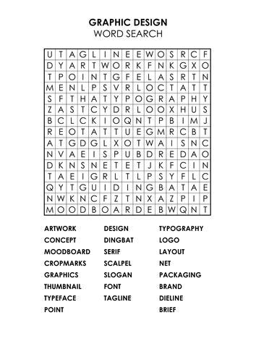
Higher Graphic Communication
Study Skills
Activity 3 – Using SQA & Course Materials Step 4 Create a wordsearch of at least 10 × 10 squares. You can make it as big as you like but keep it realistic. Work together with a group of friends. Many apps allow you to make wordsearch puzzles online. The words and phrases can go in any direction and phrases can be split. Your puzzle must only contain facts linked to the topic you are revising. The task is to find 10 bits of information to hide in your puzzle, but you must not repeat information that you used in Step 3. |  | Step 6 As you have been doing the puzzles, your brain has been actively searching for new information. Now write a NEW LIST that contains only the new information you have discovered when doing the puzzles. Your new list is the one to look at repeatedly for short bursts over the next few days. Try to remember more and more of it without looking at it. After a few days, you should be able to add words from your second list to your first list as you increase the information in your long-term memory. FINALLY! Be inspired... Make a list of different revision ideas and beside each one write THINGS I HAVE tried, THINGS I WILL try and THINGS I MIGHT try. Don’t be scared to look at new ways of studying… there might just be a method that works for you!
DO NOT show where the words are. Fill up empty squares with random letters. Remember to keep a note of where your answers are hidden but do not show your friends. When you have a complete puzzle, exchange it with a friend to solve each other’s puzzle.
Step 5
Now make up 10 questions (not “ answers” this time) based on the same section used in the previous two tasks. You must find NEW information that you have not yet used. Again, give your questions to a friend to answer.

Slide 14
Higher Graphic Communication
Study Skills
Resources for Studying Higher Graphic Communication Books:
Resources: SQA past papers, Marking Schemes and Information is available on the SQA website or ‘Click’ on the links below:
Websites https://www.bbc.co.uk/bitesize/subjects/zcrk2hv
https://www.bbc.co.uk/bitesize/topics/zw7tvcw/resources/1
https://blogs.glowscotland.org.uk/nl/ghstechnical/higher-graphic-communication/
https://www.understandingstandards.org.uk/Subjects/GraphicCommunication/higher/QuestionPaper
OneNote
HGC – 5E
Teams HGC- 5E
OneNote
HGC – 5C
Teams HGC- 5C
SQA Exams

Slide 15
Higher Design and Manufacture
SQA Study Skills 20-21

Slide 16
Higher Design and Manufacture
Higher DM - Learning Intentions Throughout this presentation you will gain an understanding of:
Resources used for studying Higher Design and Manufacture
Studying methods and techniques
SQA command words

Slide 17
Higher Design and Manufacture
Resources for Studying Higher Design and Manufacture Books
Leckie Course Notes – NEW Higher Design and Manufacture (second edition) : Revise for SQA Exams. This is available online and in all major book stores RRP £19.99
Past Papers SQA past papers are available alongside the making schemes on the SQA website or via the link below: https://www.sqa.org.uk/sqa/47927.html
Gymnastics

Slide 18
Higher Design and Manufacture
Studying Methods and Techniques Try to be active when you study, while reading is important it is not a technique on its own. Ensure you do ‘something’ with the information you have read. What is ‘something’ …
Colour Coding (Note Taking) Write down in your own words what you have read. By doing this you can are showing an understanding of your reading. Note taking can be colour coded for example write down aesthetic qualities in blue, list the description words in green and effects in red. This will help you form a descriptive answer for an aesthetics question in the exam. See example opposite.
Gymnastics

Slide 19
Higher Design and Manufacture
Studying Methods and Techniques Mind Maps (Note Taking) Mind maps can be more effective than other brainstorming and linear note-taking methods for a number of reasons; mind maps link and group concepts together through natural associations. This helps generate more ideas, find deeper meaning in your subject, and also prompt you to fill in more or find what you're missing. See opposite for example of members of the design team. Flash Cards (Note Taking) Create flash cards and use them to play memory games. Get people to ask you questions regarding the information on the cards. You can find revision cards for Design and Manufacture here: https://www.technologystudent.com/despro_flsh/all_revcards1.html This may inspire you to make your own too.
Gymnastics

Slide 20
Higher Design and Manufacture
Studying Methods and Techniques
Flow charts and Diagrams
Flow charts are a visual way to remember information. They can help you remember a path or a process. See example opposite for Design and Manufacture.
Memory Place All it means is visualising a familiar place, such as your home, and imagining a particular route through your home, taking in key features. You then place topics or information you want to remember at these key points in the house, which leads to associated memory. The last step is to practice mentally walking this route through your home until you have retained the information.
Metals
Ferrous (contains iron and rusts)
Tool Steel Hard but brittle, less malleable than mild steel, good electrical and thermal conductivity
Cast Iron Brittle if thin, can be cast in a mould, strong compression strength, good electrical and thermal conductivity but poor resistance to corrosion
Non – Ferrous (doesn’t contain iron, not magnetic and doesn’t rust)
Copper An excellent electrical conductor of heat and electricity, extremely malleable and can be polished, oxidises to a green colour
Gymnastics

Slide 21
Higher Design and Manufacture
Studying Methods and Techniques Mnemonics A mnemonic is a tool that helps us remember certain facts or large amounts of information. They can come in the form of a song, rhyme, acronym, image, phrase, or sentence. Mnemonics help us remember facts and are particularly useful when the order of things is important. See example opposite for the design process. https://www.youtube.com/watch?v=Js5Tm1y0igY Revising with Others (Discussions, Q&A) You can use Teams to have discussions with your class mates. You can also ask your teachers questions on here. You can create Kahoot’s or quizzes and share them with the members in your class.
Brian Brief Ran Research Screaming Specification Is Initial Ideas Drinking Development Soda Solution Popular Planning for Manufacture
Gymnastics

Slide 22
Higher Design and Manufacture
Studying Methods and Techniques Now that you have studied the course content. Now try to apply the knowledge you have learned by answering SQA past paper or revision questions.
You can start by answering the exam style questions in open book conditions. Having your study materials close by to help you.
Now try to answer them under closed book conditions. Checking your answers against the marking instructions.
Next time yourself – try to finish the questions under the time frame of the final exam. But before you so this lets look at the command words used by SQA …

Slide 23
Higher Design and Manufacture
Studying Methods and Techniques Now that you have studied the course content. Now try to apply the knowledge you have learned by answering SQA past paper or revision questions.
You can start by answering the exam style questions in open book conditions. Having your study materials close by to help you.
Now try to answer them under closed book conditions. Checking your answers against the marking instructions.
Next time yourself – try to finish the questions under the time frame of the final exam. But before you so this lets look at the command words used by SQA …

Slide 24
Higher Design and Manufacture
SQA Command Words
In SQA exams they use command words to indicate the type of response they are looking for the candidate to make. It is important to note at Higher level SQA do not accept bullet point answers. Identify, name and state command words are mostly combined with either describe, explain, discuss or outline command words at Higher level for Design and Manufacture. See example below.
We will look at each of the following command words in depth and provide you with an example of expected responses:
Describe
Explain
Discuss

Slide 25
Higher Design and Manufacture
SQA Command Words
Describe ‘Where a question asks a candidate to describe, they must provide a statement or structure of characteristics and/or features. This should be more than an outline or a list. It may refer to, for example, a concept, process, experiment, situation, or facts, in the context of and appropriate to the question.’
Question | How to build a response | Answer
A company has commissioned a designer to produce a range of kitchen accessories suitable for users with limited manual dexterity and two of their product ideas are shown below. Describe the physiological needs the designer might find within the user group. (2) | You are expected to describe the physiological needs, drawing from: strength issues fatigue dexterity mobility | Two physiological needs at 1 mark each. Some users may not have enough strength to open jars. (1 mark) The may also have difficulty in holding/manipulating kitchen accessories. (1 marks) *Note – statement of a fact is made linking to the context of the question.

Slide 26
Higher Design and Manufacture
SQA Command Words
Explain ‘Where a question asks candidates to explain, they must relate cause and effect and/or make relationships between things clear, in the context of the question or a specific area within the question.’
Question | How to build a response | Answer
A bicycle is shown below. Explain two benefits of using CAD computer technology in the development of they bicycle. (2) | You are expected to explain two benefits CAD would offer during the bicycle’s development. It is likely that these explanations will refer to benefits such as: making it easier to alter the design a library of parts could be used to speed up the production of designs carrying out stress analysis on parts/components before prototyping/manufacture the design can be easily rendered to provide visuals for clients easier to communicate design information with other members of the design team | CAD can make it easier to make alterations to the design. This avoids having to completely redraw aspects of the bicycle’s design (1 mark). CAD can make it easier to communicate with other members of the design team as much of the design work can be e-mailed or communicated across the team(s). (1 mark) *Note – the part highlighted in red goes on to explain the benefit. Answer linked to context of question.

Slide 27
Higher Design and Manufacture
SQA Command Words
Discuss ‘Where a question asks candidates to discuss, they must communicate ideas and information on a subject. It may be possible to debate two sides of the statement.’
Question | How to build a response | Answer
Two razors are shown below. Their aesthetics are significantly different. Discuss the aesthetics of the razors. (you must refer to four aesthetic features) (4) | Firstly you must refer to four aesthetic qualities of the razors. You could discuss the following qualities: shape fashion line style/brand form contrast proportion harmony pattern balance/symmetry light market trends texture aesthetics for function colour suitability for t.market | In the Gillette razor there is a contrast in colour between the silver of the body and orange of the logo. (1 mark) There is also contrast of textures between the smooth body and rubbery grip. (1 mark) The rubbery grip make the razor look more secure to hold when it’s wet. (1 mark — aesthetics for function). The polished silver finish of the Gillette razor looks more modern than the matte finish of the non branded razor. (1 mark – comparison between two razors) * Note - You may be given two products. If so you can debate by highlighting comparisons or contrasts between them or you can simply communicate what you think about one particular product.

Slide 28
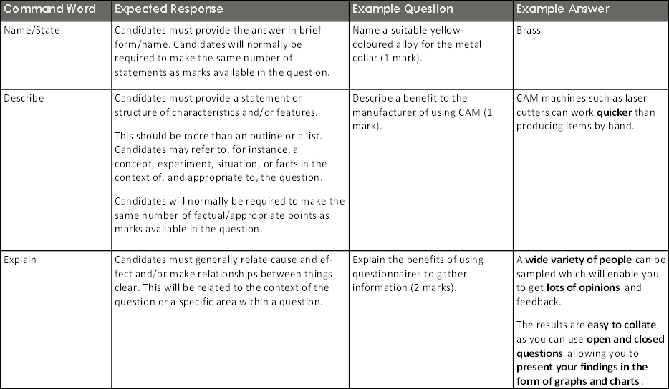
Higher Design and Manufacture
SQA Command Words

Slide 29
Higher Engineering Science Study Skills
Higher Engineering Science

Slide 30
Higher Engineering Science
Learning Intentions Throughout this presentation you will gain an understanding of:
How to prepare for studying
Resources used for studying Higher Engineering Scence
Studying methods and techniques
SQA command words

Slide 31
Higher Engineering Science
How to prepare for studying It is essential that you take time to prepare and organise yourself before you study for all of your SQA exams.
General preparation:
Leave enough time to revise – do not cram revision in the night before an exam
Keep your class notes and jotters neat and organised throughout the academic year
Find a quiet place to study and organise your materials
Put your mobile phone off and in another room
Eat ‘brain food’ before you begin studying
Set goals and take regular breaks to retain your attention and focus (study a little and often) Why not try out the Pomodoro technique: https://www.youtube.com/watch?v=1l4w7uHdNaQ

Slide 32
Higher Engineering Science
How to prepare for studying Revision Timetable It is important to manage your time. Create a revision timetable and allocate time to each of your subjects. Remember to leave time for breaks and revision should be done in short chunks of time. See example:
School Day
Design & Man.
School Day
PE
Gymnastics
School Day
English
School Day
Maths
Football
Biology Supported study
School Day
Design & Man.
PE
English
Family Sunday lunch
Maths
Biology

Slide 33
Higher Engineering Science
Weekly Revision Timetable

Slide 34
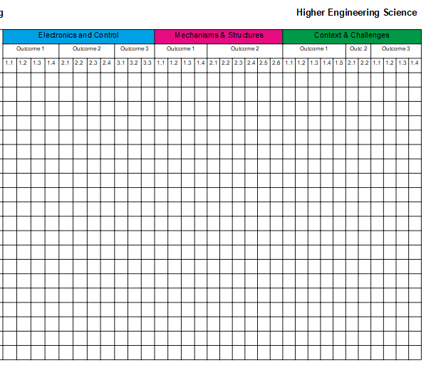
Higher Engineering Science
How to prepare for studying What to Study?
Break studying down into each unit of work. Use the course specification on OneNote as a revision checklist. See link below: Course Checklist (Web view)
Now time to reflect. For each unit of work, highlight your strengths and areas for improvement – this information could come from end of unit tests, test evaluation forms, feedback of coursework and homework. Highlight strengths in green on the revision checklist. These areas should be re-capped. Highlight in amber or red areas you found more challenging. More in-depth revision can be done for these areas.
Gymnastics

Slide 35
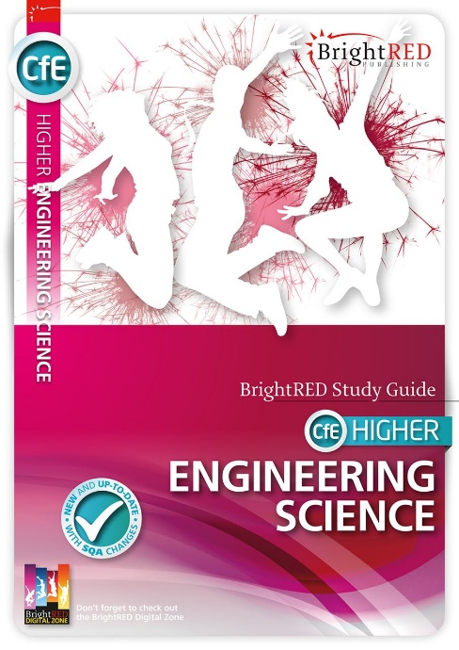
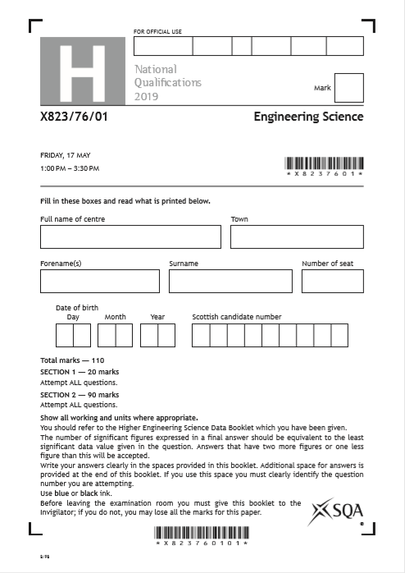
Higher Engineering Science
Resources for Studying Higher Engineering Science Books
Bright Red Study Guides – Higher Engineering Science This is available online and in all major book stores RRP £12.99
Past Papers SQA past papers are available alongside the making schemes on the SQA website or via the link below: SQA Past Papers
Online Resources - YouTube Tutorials or Engineering 101
Gymnastics

Slide 36
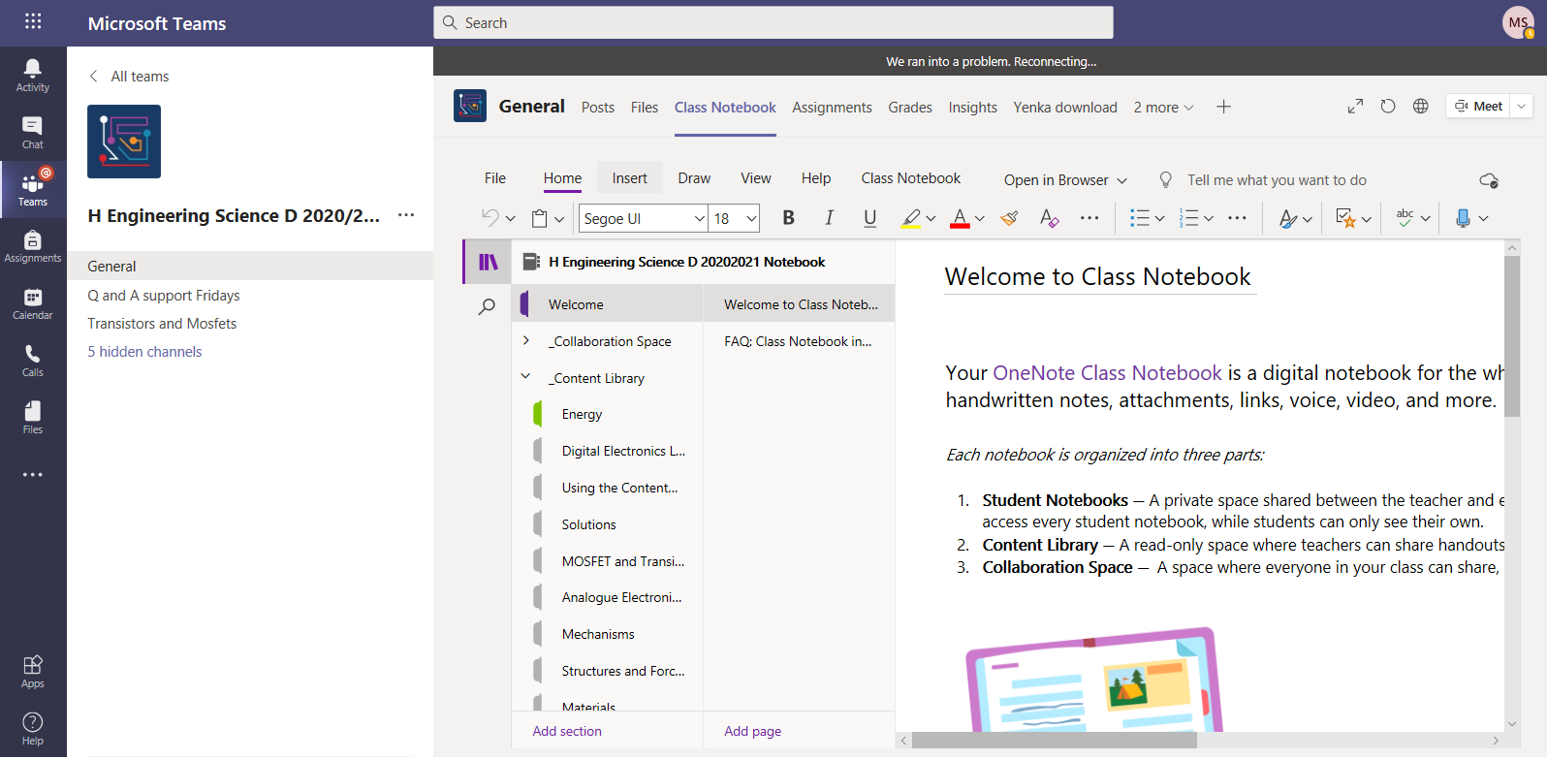
Higher Engineering Science
Resources for Studying Higher Engineering Science Class Notes
Course notes provided throughout the year by your teacher can be used to help you revise each unit of work covered in class.
Microsoft Teams and OneNote Accessing Microsoft Teams via Glow will enable you to gain access to digital copes of class notes and PowerPoint presentations they are organised in Channels by topic. All notes are contained in the files section. You can access old assignments that you have completed to see feedback and re-attempt tasks. OneNote which is accessed via Teams contains a variety of your course notes, revision materials and class work.
Gymnastics

Slide 37
Higher Engineering Science
Studying Methods and Techniques Try to be active when you study, while reading is important it is not a technique on its own. Ensure you do ‘something’ with the information you have read. What is ‘something’ …
Colour Coding (Note Taking) Write down in your own words what you have read. By doing this you are showing an understanding of your reading. Note taking can be colour coded for example, this could be used in
Mechanisms to identify different directions of movement.
Gymnastics

Slide 38
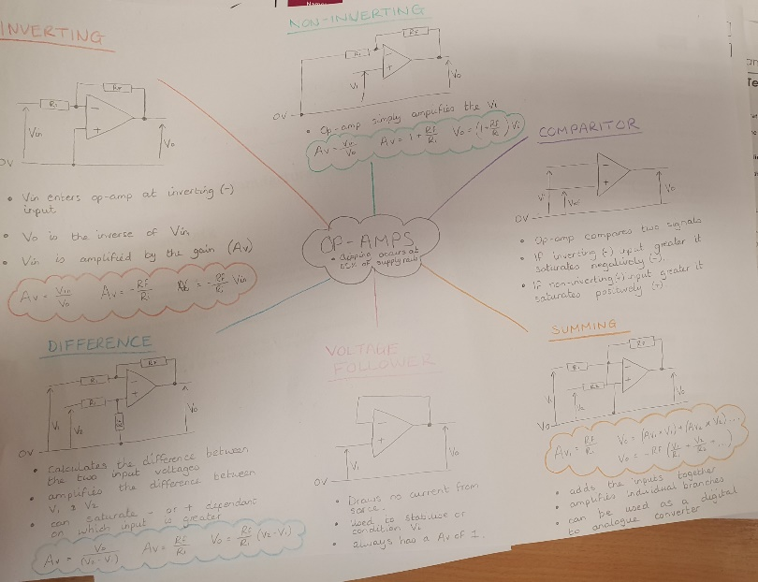
Higher Engineering Science
Studying Methods and Techniques Mind Maps (Note Taking) Mind maps can be more effective than other brainstorming and linear note-taking methods for a number of reasons; mind maps link and group concepts together through natural associations. This helps generate more ideas, find deeper meaning in your subject, and also prompt you to fill in more or find what you're missing. See opposite for example of for Op-Amps. Flash Cards (Note Taking) Create flash cards and use them to play memory games. Get people to ask you questions regarding the information on the cards. You can find revision cards for Design and Manufacture here: Higher Engineering Science Flashcards This may inspire you to make your own too.
Gymnastics

Slide 39
Higher Engineering Science
Studying Methods and Techniques
Flow charts and Diagrams
Flow charts are a visual way to remember information. They can help you remember a path or a process. See example opposite for Engineering Science.
Memory Place All it means is visualising a familiar place, such as your home, and imagining a particular route through your home, taking in key features. You then place topics or information you want to remember at these key points in the house, which leads to associated memory. The last step is to practice mentally walking this route through your home until you have retained the information.
Motion
Linear
Car travelling in one directon, Elevator
Reciprocating
Swing, Pedulum
Rotary
Oscillating
Wheels, Hands of a clock
Sewing machine, Engine piston
Gymnastics

Slide 40
Higher Engineering Science
Studying Methods and Techniques Mnemonics A mnemonic is a tool that helps us remember certain facts or large amounts of information. They can come in the form of a song, rhyme, acronym, image, phrase, or sentence. Mnemonics help us remember facts and are particularly useful when the order of things is important. See example opposite for the design process. https://www.youtube.com/watch?v=Js5Tm1y0igY Revising with Others (Discussions, Q&A) You can use Teams to have discussions with your classmates. You can also ask your teachers questions on here. You can create Kahoot’s or quizzes and share them with the members in your class.
Should Strength Everyone Elasticity Play Plasticity Dominoes Ductility By Brittleness Moonlight Malleability
Gymnastics

Slide 41
Higher Engineering Science
Studying Methods and Techniques Now that you have studied the course content. Now try to apply the knowledge you have learned by answering SQA past paper or revision questions. (Remember you will be given a data booklet for use in exams/ assignments with all the formulae and other technical information you will need. Make sure you are familiar with it - Data Booklet
You can start by answering the exam style questions in open book conditions. Having your study materials close by to help you.
Now try to answer them under closed book conditions. Checking your answers against the marking instructions.
Next time yourself – try to finish the questions under the time frame of the final exam.
But before you so this lets look at the command words used by SQA …

Slide 42
Higher Engineering Science
SQA Command Words
In SQA exams they use command words to indicate the type of response they are looking for the candidate to make. It is important to note at Higher level SQA do not accept bullet point answers. Calculate, state, describe and explain command words are used at Higher level Engineering Science. See examples below.
We will look at each of the following command words in depth and provide you with an example of expected responses:
Calculate
Describe
Explain

Slide 43
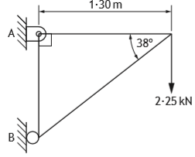
Higher Engineering Science
SQA Command Words
Calculate ‘Where a candidate makes an error at an early stage in a multi-stage calculation, marks will be awarded for correct follow-on working in subsequent stages. Marks will not be awarded if the error significantly reduces the complexity of the remaining stages.’
‘The number of significant figures expressed in a final answer should be equivalent to the least significant data value given in the question. Answers that have two more figures or one less figure than this will be accepted.’
Q. Calculate the magnitude and indicate the direction of the reaction at B?
Answer: Rounded to two significant figures:

Slide 44
Higher Engineering Science
SQA Command Words
Describe ‘Where a question asks a candidate to describe, they must provide a statement or structure of characteristics and/or features. This should be more than an outline or a list. It may refer to, for example, a concept, process, experiment, situation, or facts, in the context of and appropriate to the question.’

Slide 45
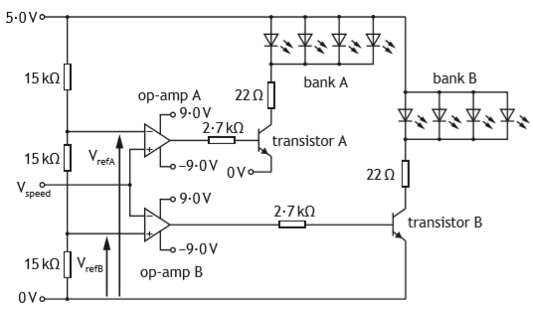
Higher Engineering Science
Describe - continued
Question | How to build a response | Answer
Describe, with reference to the circuit diagram, what happens to the LEDs as the voltage from the speed sensor (Vspeed) rises from 0 V to 5∙0 V. | You are expected to describe the functionality of the circuit referring directly to the circuit diagram: LED condition when speed below reference speed LED condition when speed equal to reference speed LED condition when speed above reverence | 1 mark for each relevant description, up to a total of 6. Max 2 marks awarded for each lighting condition. Bank B lighting / Vspeed = 0 – 1.67 V Initially, Vspeed will be below the VrefB so op-amp B will be saturated positive. This will cause transistor B to switch on, causing bank B to light. This will cause op-amp A to saturate negatively causing bank A to be off. Neither bank lighting / Vspeed = 1.68 – 3.36 V When Vspeed is between the two reference voltages neither bank will be on. When Vspeed is greater than VrefB op-amp B will saturating negative. This switches off transistor B and bank B. When Vspeed is less than VrefA op-amp A will saturate negative. This switches off transistor A and bank A. Bank A lighting / Vspeed = 3.37 – 5.0 V When Vspeed is greater than VrefA it will saturate op-amp A positive. This causes transistor A to switch on, this causes bank A to turn on. This will cause op-amp B to remain saturated negatively causing bank B remain off.

Slide 46
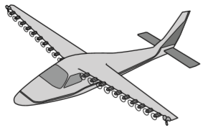
Higher Engineering Science
SQA Command Words
Explain For ‘Explain’ questions, only award marks where the candidate goes beyond a description, for example by giving a reason, or relating cause to effect, or providing a relationship between two aspects.
Question | How to build a response | Answer
Improving efficiency is a key task for the engineers who design the aeroplane. (c) Explain one economic and one social impact of improving the efficiency of the aeroplane. Economic ____________________ Social _______________________ | You are expected to explain two impacts of improving efficiency. One linked to Economic and one Social. Economic - Reduces running cost (Effect) due to less electricity being used (Cause). Social: Longer flight times would be possible (Cause) allowing people to travel further without stop-over (Effect). | Economic: Reduces running cost due to less electricity being used. Social: Longer flight times would be possible allowing people to travel further without stop-over. Must refer to cause and effect. Answer linked to context of question Any other relevant answer will be accepted as long as there is a cause and effect.

Slide 47
Higher Engineering Science
SQA Command Words
Command Word | Expected Response | Example Question | Example Answer
Name/ State | Candidates must provide the answer in brief form/ name. Candidates will normally be required to make the same number of statements as there are marks available. | State the op-amp configuration required to perform this task? (1 Mark) | Summing amplifier.
Describe | Where a question asks a candidate to describe, they must provide a statement or structure of characteristics and/or features. This should be more than an outline or a list. It may refer to, for example, a concept, process, experiment, situation, or facts, in the context of and appropriate to the question. | Describe how the gain of the op-amp circuit could be increased? (1 Mark) | By increasing the value of Rf (Feedback Resistance). By decreasing the value of Ri (Input Resistance). Increasing the ratio of Rf to Ri.
Explain | For ‘Explain’ questions, only award marks where the candidate goes beyond a description, for example by giving a reason, or relating cause to effect, or providing a relationship between two aspects. | Explain why the engineer chose to use the NAND equivalent circuit in the product rather than the original circuit? (1 Mark) | Fewer ICs means simpler construction. Fewer ICs means smaller product size. Fewer ICs means reduced cost. Buying NAND gates in bulk would be lower in cost than buying different types of gates to perform the same function.

