Slide 1
HIGHER ACCOUNTING SQA EXAM GUIDE
2020-21

Slide 2

Why Bother?
Because being prepared and exam technique can make
a significant difference to your final grade

Slide 3
QUESTION PAPER
The question paper consists of 2 Sections – ALL QUESTIONS ARE COMPULSORY
SECTION 1 – 80 marks (2 x 40 mark questions)
SECTION 1 – 40 marks (2 x 20 mark questions)

Slide 4

Timings

Slide 5
You will have 2 hours and 30 minutes to complete this paper
Devote more time to Section 1 as there are more marks available
Section 1 = 80 marks, so 1 hour 40 minutes to complete the questions and look over your answers
Section 2 = 40 marks, so 50 minutes to complete the questions and look over your answers

Slide 6
LABEL EVERYTHING
You must make it clear to which part of the question your answer refers eg
3 a i Cost per wash £4.00
You must make sure you label the figures in your answer
Eg £0.02 per passenger mile
YOU WILL NOT BE AWARDED MARKS FOR UNSUPPORTED OR UNLABELLED FIGURES ON YOUR PAPER

Slide 7
Exam technique – keep your eye on your timing – don’t waste time over a 2 mark section at the end of a question where you could pick up easier marks from the start of the next question. Leave it and return to it at the end if you have time
Assume that the person marking your paper is an intelligent adult who knows very little about Accounting – be specific and qualify theory answers

Slide 8
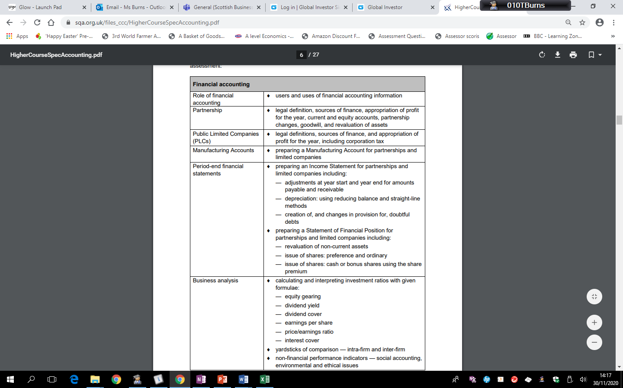
COURSE CONTENT - FINANCIAL

Slide 9
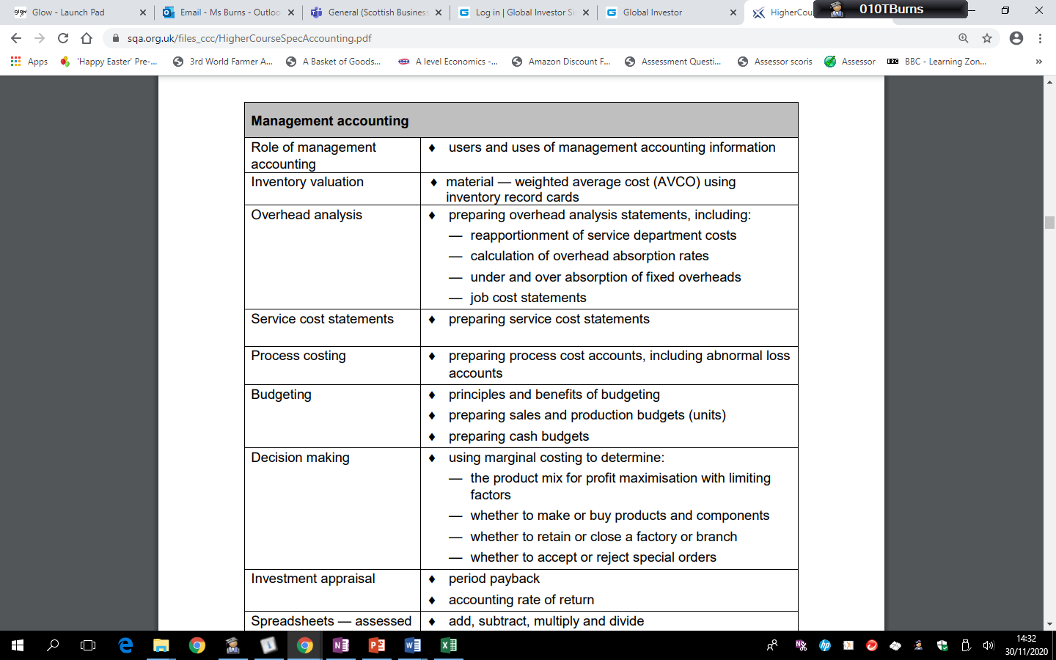
COURSE CONTENT - management

Slide 10

Hints and tips
Weekly past paper practise
Weekly revision of different topics
Timing – time yourself to take no longer than 1.25 minutes per mark

Slide 11


REMEMBER!!!
Basic knowledge – learn your layouts and the tricky things to look out for that your teacher has discussed with you
Exam technique – keep your eye on your
timing – don’t waste time over a 2 mark section at the end of a question where you could pick up easier marks from the start of the next question
Practise – as with everything – the more
practise you do, the better you become

Slide 12
PREVIOUS PAST PAPER CONTENT
2019 – 120 marks | Q1 – 40 marks | Q2 – 40 marks | Q3 – 20 marks | Q4 – 20 marks
2020
2019 | Job Costing and Overheads | Decision making and Process Costing | Manu Acc and Inc Statement | PLC Inc Stat and SOFP
SPEC 2019 ON | Partnerships | Budgets & Process Costing | Ratio analysis & Materials | Investment appraisal
 | Q1 – 40 marks | Q2 – 20 marks | Q3 – 20 marks | Q4 – 20 marks
2018 | PLC | Ratios & invest appraisal | Materials and Process Costing | Budgets
2017 | Overheads | Cash Budget | Manu Acc & Inc Statement | Dec Making
2016 | Decision Making | Overheads | Manu Acc | Partnerships
2015 | Partnerships | Cash Budget | Ratios & invest appraisal | Service Costing
SPEC | Overheads and Job Costing | Ratios & invest appraisal | Manu Acc & Inc Statement | Partnerships
EXEMPLAR | PLC Inc Stat & SOFP | Cash budget | Ratios & Process Costing theory | Decision Making

Slide 13
TEMPLATES
All templates, questions from the course and solutions will be stored in your Class Notebook in Teams. Further examples are provided on the next few slides.

Slide 14
PARTNERSHIPS

Slide 15
PARTNERSHIPS

Slide 16
PARTNERSHIPS

Slide 17
PLC

Slide 18
PLC

Slide 19
INVENTORY (MATERIALS)

Slide 20
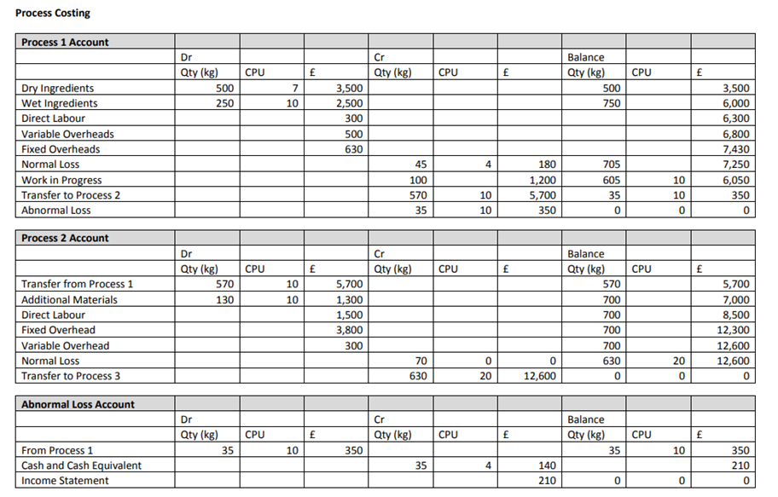
PROCESS COSTING

Slide 21

Good luck!!!

